Slide 1




21.08 Release
@RAPIDSai
https://github.com/rapidsai
https://rapids-goai.slack.com/join
https://rapids.ai
Notes:
https://rapids.ai/ https://github.com/rapidsai
https://docs.rapids.ai/overview

Slide 2
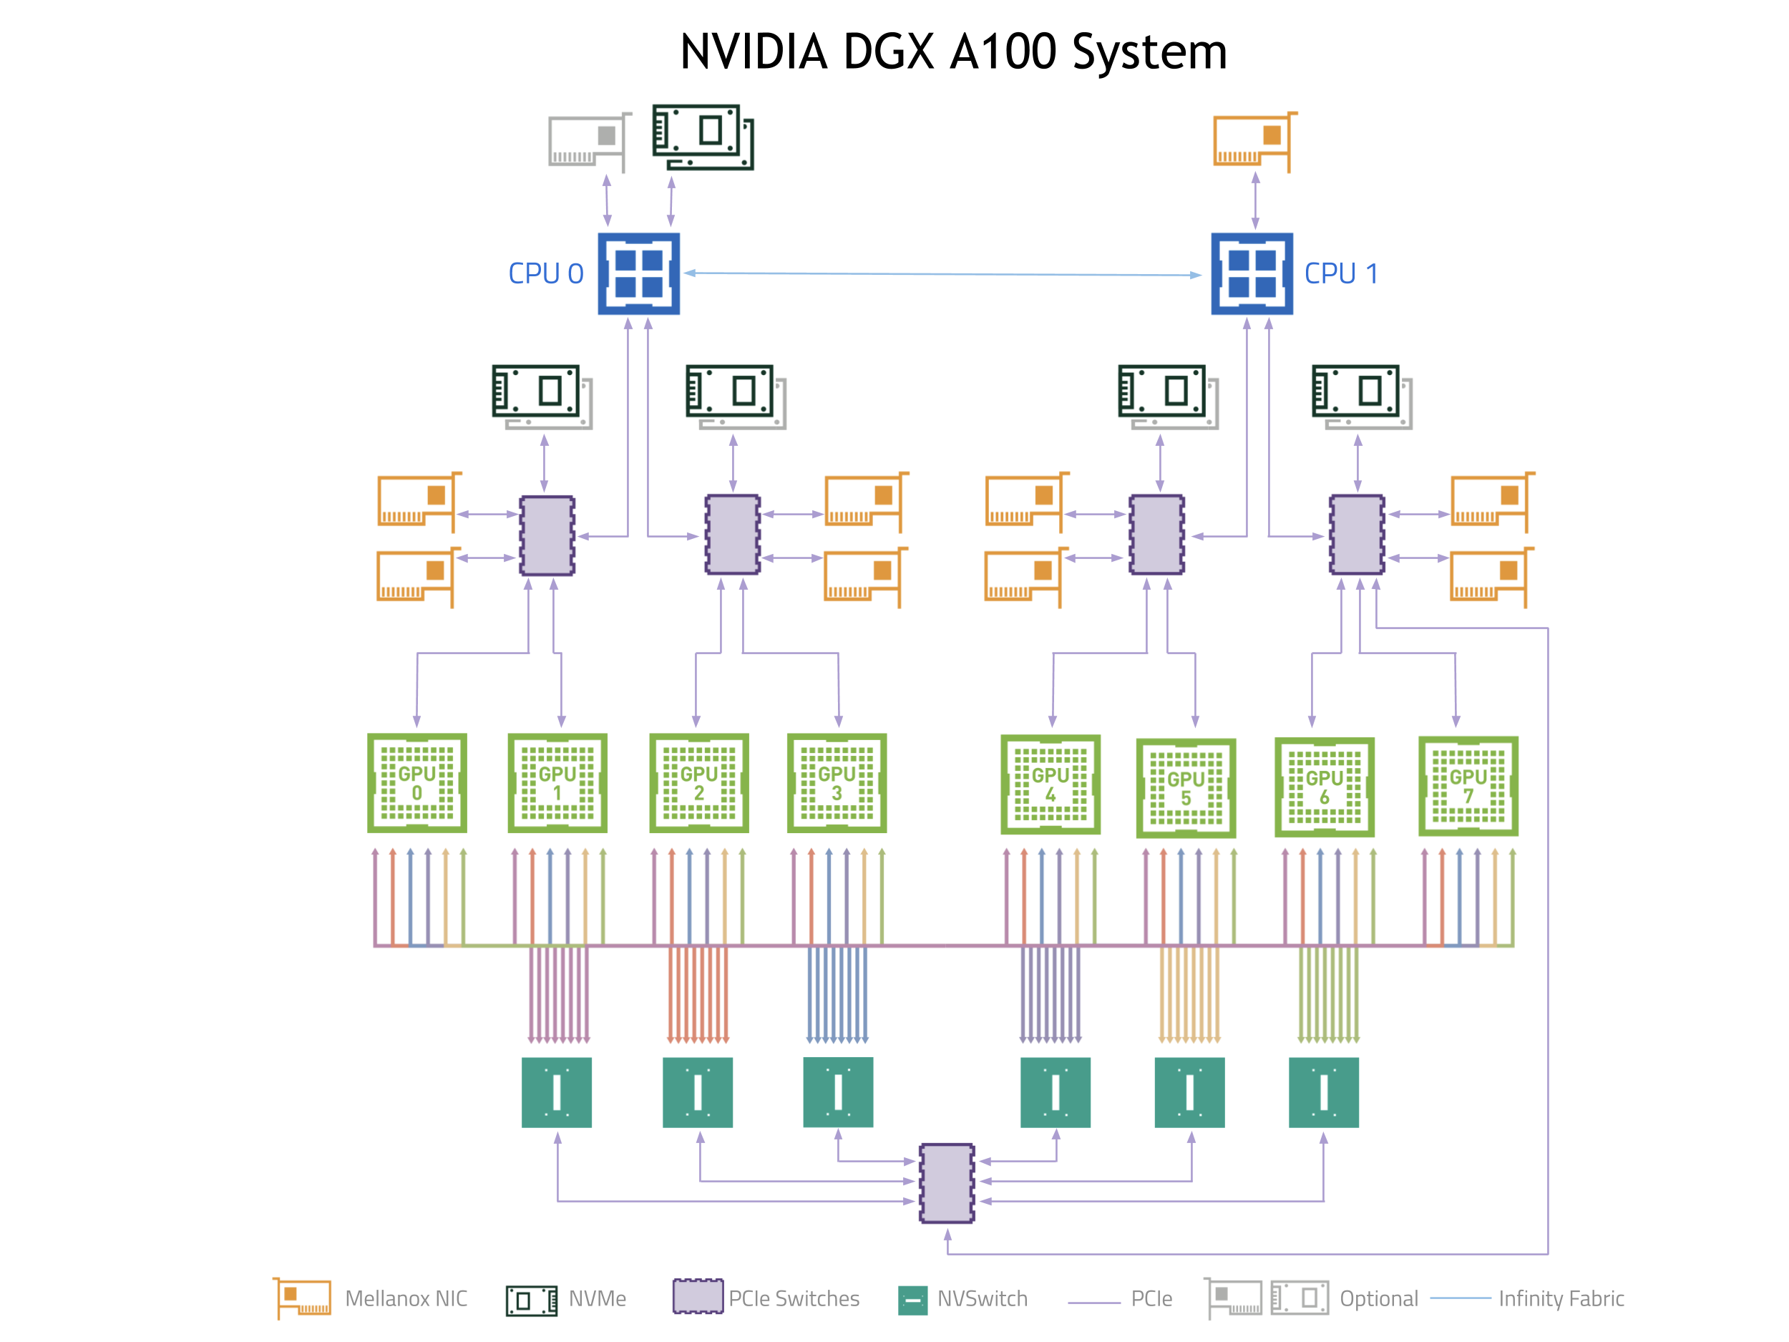
Why GPUs for Data Science?
Numerous hardware advantages
Thousands of cores with up to ~20 TeraFlops of general purpose compute performance
Up to 1.5 TB/s of memory bandwidth
Hardware interconnects for up to 600 GB/s bidirectional GPU <--> GPU bandwidth
Can scale up to 16x GPUs in a single node
Almost never run out of compute relative to memory bandwidth!

Slide 3
What is RAPIDS?
End-to-End GPU Accelerated Data Science
Data Preparation/ETL
Analytics/ML/Graph
Visualization
cuDF
GPU-accelerated ETL functions
Tracks pandas and other common PyData APIs
Dask + UCX integration for scaling
RAPIDS ML
GPU-native cuML library, plus XGBoost, FIL, HPO, and more
cuGraph
GPU graph analytics, including TSP, PageRank, and more
cuxfilter
GPU-accelerated cross-filtering
pyViz integration
Plotly Dash, Bokeh, Datashader, HoloViews, hvPlot
Domain-Specific Libraries
CLX + Morpheus Cyber log processing + anomaly detection | cuSignal Signals processing | cuSpatial Spatial analytics
cuStreamz Streaming analytics | cuCIM Computer vision & image processing primitives | node-RAPIDS Bindings for node.js
...and more!

Slide 4
Overview of Changes: RAPIDS 21.08 Release
cuDF Decimal support for CSV reader, functionality to convert dataframe to struct series; fillna added to groupby; supports multiple inputs in JSON and ORC reader; list read and write support for ORC; experimental read support for structs in ORC; experimental support for null in UDFs for Python;
cuML New Bernoulli Naive Bayes model; improvements to HDBSCAN, ARIMA, FIL and Random Forest; new weighted multi-node multi-gpu KMeans algorithm; new distances added to pairwise_distances;
cuGraph Doubly Compressed Sparse Row and Doubly Compressed Sparse Column support added to libcugraph; graph batching for C++; epsilon parameter added to Hungarian algorithm; continued improving graph primitives for performance; depth limit functionality on traversal algorithms; Enhanced multi-gpu scaling
CLX Maintenance to existing code; working through including CLX use cases in Morpheus
cuCIM Add functionality to perform morphological thinning of a binary image

Slide 5
cuDF Updates: Deep Dive
Release 21.08
Features added in 21.08
Decimal data type is now supported for csv reader function in Python
List read and write, and experimental read support for structs in ORC
Read_json supports reading multiple input files/buffers
Fillna feature added to groupby
Experimental support for handling null in UDFs for Python
cuDF Dataframe has new functionalities for structs : to_struct and explode methods
Planned Upcoming Features
Expanded support for additional decimal types
Enhanced ORC struct and map support
Conditional equijoins support in libcudf
Notes:
Medium blog title : Lookout, nested types are now supported in RAPIDS cuDF!

Slide 6
cuML Updates: Deep Dive
Release 21.08
Features added in 21.08
Single-GPU implementation of Bernoulli Naive Bayes algorithm
Added support for chebyshev, canberra, hellinger and minkowski distances for pairwise distance calculations
Vector leaf prediction and significant improvements and optimizations to the Forest Inference Library (FIL)
GTIL (General Tree Inference Library) for CPU inference was introduced to the FIL backend for Triton
Multiple improvements to the new Random Forest backend to optimize memory and performance.
Add weighted KMeans sampling for KernelSHAP
Support for weighted sampling in the multi-node multi-gpu KMeans algorithm
Many more model-specific improvements and bug fixes: ARIMA memory improvements, dtype conversion optimization for FIL, multiple HDBSCAN improvements ...
Planned Upcoming Features
Categorical features support in FIL
Support for missing observations, padding and exogenous variables for ARIMA
Single-node single-GPU implementation of Gaussian Naive Bayes

Slide 7
cuGraph Updates: Deep Dive
Release 21.08
Features added in 21.08
Doubly Compressed Sparse Row and Doubly Compressed Sparse Column support added to libcugraph
Epsilon parameter is now supported in the Hungarian algorithm
Random Walk updated to improve performance
Resolve tech debt and enhance the library
Depth limit functionality on traversal algorithms
Addressed issues with multi-gpu scaling
Planned Upcoming Features
Biased Random Walk
Multi-Seed Breadth First Search
Multi-GPU Triangle Counting
Multi-GPU HITS

Slide 8




Join the Conversation
GOOGLE GROUPS
DOCKER HUB
SLACK CHANNEL
STACK OVERFLOW
https://groups.google.com/forum/#!forum/rapidsai
https://hub.docker.com/r/rapidsai/rapidsai
https://rapids-goai.slack.com/join
https://stackoverflow.com/tags/rapids

Slide 9
THANK YOU
@RAPIDSai
Notes:
https://rapids.ai/ https://github.com/rapidsai
https://docs.rapids.ai/overview

